Slide 1
CompTIA A+ Guide to IT Technical Support
10th Edition

Slide 2
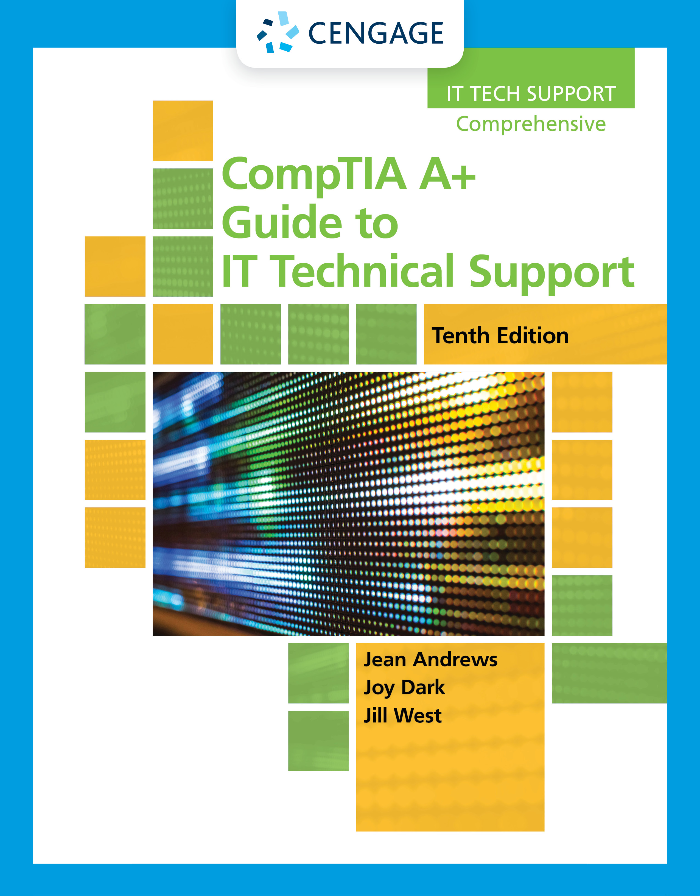
Supporting Hard Drives and Other Storage Devices
Chapter 5

Slide 3
Objectives
Describe and contrast technologies used inside a hard drive and how a computer communicates with a hard drive
Select, install, and support a hard drive
Identify tape drives and tape cartridges
Support optical drives, solid-state storage, and flash memory devices
Troubleshoot hard drives

Slide 4
Hard Drive Technologies and Interface Standards
A hard disk drive (HDD) is rated by its:
Physical size
Capacity
Speed
Technologies used inside the drive
Interface standards

Slide 5
Technologies and Form Factors of Hard Drives (1 of 7)
Two types of hardware technologies used inside the drive are magnetic and solid-state
Magnetic Hard Drives
One, two, or more platters, or disks
Stacked together, spinning in unison inside a sealed metal housing
Firmware controls data reading, writing and motherboard communication
Read/write heads are controlled by an actuator
Data is organized in concentric circles, called tracks
Tracks are divided into segments called sectors
Most current drives use 4096-byte sectors
Form factors for internal magnetic hard drives are 3.5” for desktops and 2.5” for laptop computers

Slide 6
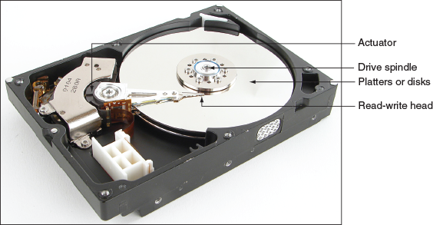
Technologies and Form Factors of Hard Drives (2 of 7)
Figure 5-1 Inside a magnetic hard drive

Slide 7
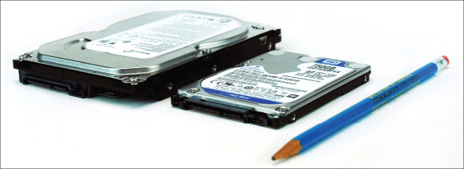
Technologies and Form Factors of Hard Drives (3 of 7)
Figure 5-3 A magnetic hard drive for a desktop is larger than that used in laptops

Slide 8
Technologies and Form Factors of Hard Drives (4 of 7)
Solid-state drive (SSD)
Also called a solid-state device
No moving parts
Built using nonvolatile memory, similar to that used for USB flash drives
Memory in an SSD is called NAND flash memory
Life span is based on the number of write operations to the drive
Expressed as TBW (TeraBytes Written) or DWPD (Drive Writes Per Day)
Solid-state drives are more expensive than magnetic hard drives, but they are faster, more reliable, last longer, and use less power than magnetic drives
Three popular form factors used by SSDs:
2.5” SSD, M.2 SSD card, and PCI Express SSD expansion card

Slide 9
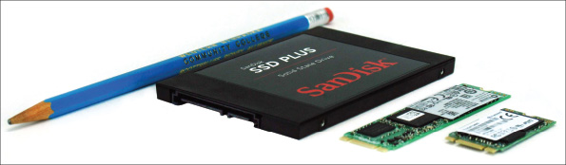
Technologies and Form Factors of Hard Drives (5 of 7)
Figure 5-5 Solid-state drives in two form factors: 2.5” SSD and two lengths of M.2 SSD cards

Slide 10
Technologies and Form Factors of Hard Drives (6 of 7)
Hybrid Hard Drives
A hybrid hard drive (H-HDD) is sometimes called a solid-state hybrid drive (SSHD)
Contains both magnetic and SSD technologies
The magnetic drive in the housing permanently holds data
The flash component serves as a buffer to improve drive performance
The operating system must support a hybrid drive in order for it to function
Logical Block Addressing and Capacity
Low-level formatting – sector markings are written to the hard drive at the factory
Not the same as high-level formatting performed for Operating System installation
Firmware, BIOS/UEFI, and the OS use logical block addressing (LBA) to address all hard drive sectors
Size of each block + total number of blocks determine drive capacity

Slide 11
Technologies and Form Factors of Hard Drives (7 of 7)
S.M.A.R.T.
S.M.A.R.T. (Self-Monitoring Analysis ad Reporting Technology) is used to predict when a drive is likely to fail
System BIOS/UEFI uses S.M.A.R.T. to monitor:
Drive performance, temperature, and other factors
For magnetic drives, it monitors:
Disk spin-up time, distance between the head and the disk, other mechanical activities of the drive
If S.M.A.R.T. suspects a drive failure is about to happen, it displays a warning message
It can be enabled and disabled in BIOS/UEFI setup

Slide 12
Interface Standards Used by Hard Drives (1 of 11)
Four interface standards used by hard drives include:
IDE (outdated)
SCSI (outdated)
SATA
NVMe
IDE
Also known as the Parallel ATA (PATA) standards
Allowed for one or two IDE connectors on a motherboard using a 40-pin data cable
Two types of IDE cables are the older cable with a 40-pin connector with 40 wires and a newer cable with the same 40-pin connector and 80 thinner wires
The maximum recommended length of an IDE cable is 18”

Slide 13
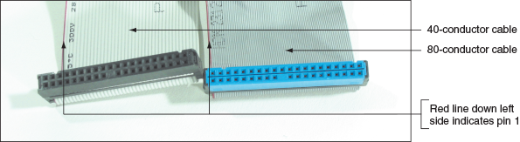
Interface Standards Used by Hard Drives (2 of 11)
Figure 5-8 In comparing the 80-conductor cable with the 40-conductor cable, note they are about the same width, but the 80-conductor cable has twice as many fine wires

Slide 14
Interface Standards Used by Hard Drives (3 of 11)
SCSI
In the past, hard drives designed for high-end workstations used the SCSI (Small Computer System Interface) interface standard
SCSI can support up to 7 or 15 SCSI-compliant devices in a system
A SCSI expansion card, called the SCSI host adapter, used a PCIe slot and provided one external connector for an external SCSI device and one internal connector for internal SCSI devices

Slide 15
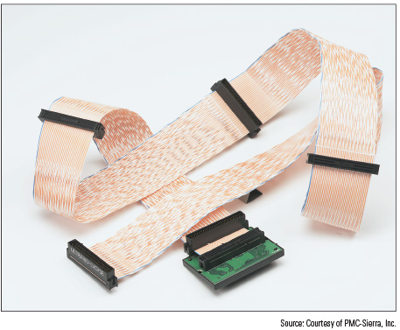
Interface Standards Used by Hard Drives (4 of 11)
Figure 5-10 This 68-pin internal SCSI ribbon cable can connect several SCSI devices

Slide 16
Interface Standards Used by Hard Drives (5 of 11)
SATA
Most hard drives today use the serial ATA or SATA interface standard
SATA uses a serial data path
A SATA data cable can accommodate a single SATA drive
Three SATA standards:
SATA3 or SATA III
SATA2 or SATA II
SATA1 or SATA I
SATA standards are used by all drive types
Supports hot-swapping (hot-plugging)
Can connect and disconnect a drive while system is running
Connects to one internal SATA connector on the motherboard via a 7-pin data cable
Uses a 15-pin SATA power connector
A motherboard might have two or more SATA connectors
Use connectors in the order recommended in the motherboard user guide

Slide 17
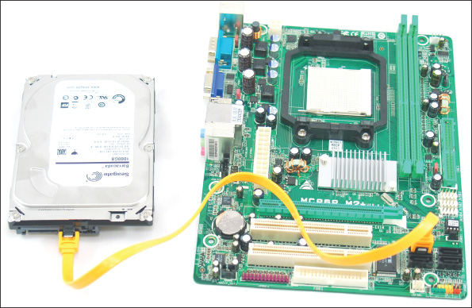
Interface Standards Used by Hard Drives (6 of 11)
Figure 5-11 A SATA cable connects a single SATA drive to a motherboard SATA connector

Slide 18
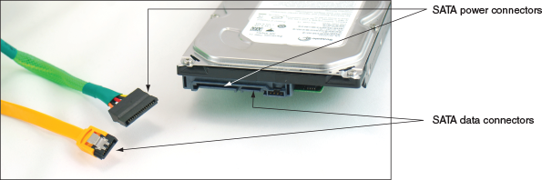
Interface Standards Used by Hard Drives (7 of 11)
Figure 5-12 A SATA data cable and SATA power cable

Slide 19
Interface Standards Used by Hard Drives (8 of 11)
The SATA 3.2 revision allows for PCIe and SATA to work together in a technology called SATA Express
Uses a new connector
SATA Express is not as fast as NVMe
A motherboard or expansion card can provide external SATA (eSATA) ports for external drives
External SATA (eSATA)
eSATA drives use a special external shielded serial ATA cable up to 2 meters long
Purchasing considerations
SATA standards for the drive and motherboard need to match
If they do not match, the system runs at the slower speed

Slide 20
Interface Standards Used by Hard Drives (9 of 11)
NVMe
NVMe (Non-Volatile Memory Express or NVM Express) interface standard is used only by SSDs
Comparisons:
The most common SATA standard, SATA 3, transfers data at 6 Gb/sec
NVMe uses the most common PCIe standard, PCIe 3.0, which transfers data at 32 Gb/sec
The PCIe NVMe interface might be used in three ways:
PCIe expansion card
U.2 slot
M.2 port

Slide 21
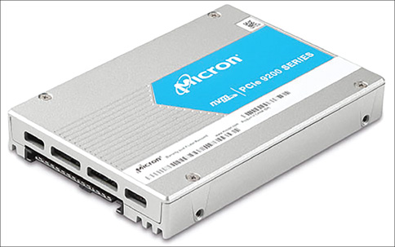
Interface Standards Used by Hard Drives (10 of 11)
Figure 5-16 A U.2 2.5” SSD uses the NVMe and PCIe interface standards and connects to a U.2 port on the motherboard

Slide 22
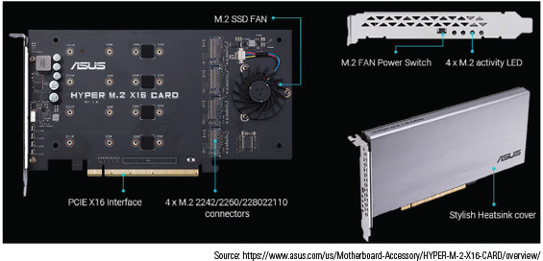
Interface Standards Used by Hard Drives (11 of 11)
Figure 5-18 Install up to four M.2 SSDs in a bootable RAID array on this adapter card by Asus

Slide 23
How to Select and Install Hard Drives
Topics covered in this part of the chapter:
Selecting a hard drive
Installation details for a SATA drive
How to install a hard drive in a bay too wide for the drive
Special considerations to install a hard drive in a laptop
How to set up a RAID system

Slide 24
Selecting a Hard Drive (1 of 3)
The motherboard and hard drive must support the same interface standard
Find out by reading the motherboard manual
Options for compatibility:
SATA ports on a motherboard are usually color-coded to indicate which SATA standard the port supports
M.2 slots might support PCIe 3.0, PCIe 2.0, SATA2, SATA3, or USB 3.0
When an M.2 port with a card installed is using the SATA bus, one of the SATA ports might be disabled
NVMe expansion cards most likely use a PCIe x4 version 3.0 slot

Slide 25
Selecting a Hard Drive (2 of 3)
Considerations when selecting a hard drive:
Technology
Form factor
Capacity
Data transfer rate as determined by the drive interface
For magnetic drives, the spindle speed, which affects performance
For hybrid drives, the cache or buffer size, which affects performance

Slide 26
Selecting a Hard Drive (3 of 3)
Manufacturer | Website
Kingston Technology (SSD only) | kingston.com
Samsung (SSD only) | samsung.com
Seagate Technology (magnetic and SSD) | seagate.com
Western Digital (magnetic and SSD) | wdc.com
Toshiba (magnetic and SSD) | Toshiba.com

Slide 27
Steps to Install a SATA Drive (1 of 8)
A SATA drive might have jumpers
Most likely set by factory as they should be
Some SATA drives have two power connectors
Choose only one to use
Never install two power cords at the same time

Slide 28
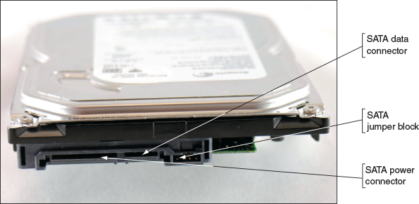
Steps to Install a SATA Drive (2 of 8)
Figure 5-19 The rear of a SATA drive

Slide 29
Steps to Install a SATA Drive (3 of 8)
Step 1: As Best You Can, Protect the User’s Data
Back up important data to other media and verify that you can access the data on that media
Step 2: Know Your Starting Point
How is your system configured?
Is everything working properly?
Write down what you know about the system
Step 3: Read the Documentation and Prepare Your Work Area
Read all installation instructions first
Visualize all the steps in the installation
Protect against ESD and avoid working on carpet

Slide 30
Steps to Install a SATA Drive (4 of 8)
Step 3: Read the Documentation and Prepare Your Work Area (continued)
Added precautions:
Handle the drive carefully
Do not touch any exposed circuitry
Prevent other people from touching exposed microchips
Drain static electricity from the package and from your body by touching metal for at least 2 seconds
If you must set it down, place it component-side up
Do not place the drive on the computer case or on a metal table

Slide 31
Steps to Install a SATA Drive (5 of 8)
Step 4: Install the Drive
Shut down the computer and unplug it
Decide which bay will hold the drive
Slide drive in the bay and secure it (use two screws on both sides)
Use correct motherboard SATA connector
Connect a 15-pin SATA or 4-pin Molex power connector from the power supply to the drive
Check all connections and power up the system
Verify the drive is recognized correctly via BIOS/UEFI setup

Slide 32
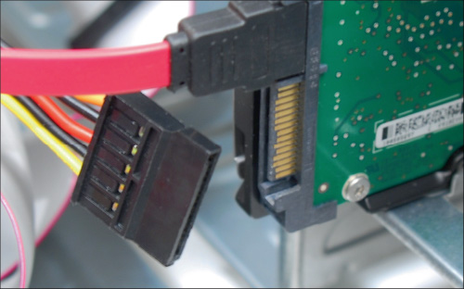
Steps to Install a SATA Drive (6 of 8)
Figure 5-26 Connect the SATA power cord to the drive

Slide 33
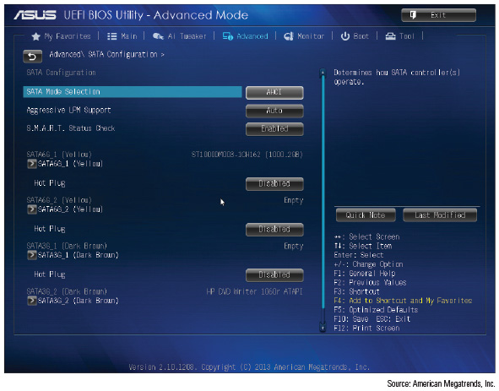
Steps to Install a SATA Drive (7 of 8)
Figure 5-27 A BIOS/UEFI setup screen showing a SATA hard drive and DVD drive installed

Slide 34
Steps to Install a SATA Drive (8 of 8)
You are ready to prepare the hard drive for first use
Boot from Windows setup DVD
Follow directions on the screen to install Windows on the new drive
If installing a second hard drive with Windows installed on the first drive use Windows Disk Management utility to partition and format the second drive

Slide 35
Installing a Drive in a Removable Bay
Unplug the cage fan from its power source
Turn handle on each locking device counterclockwise to remove it
Slide the bay to the front and out of the case
Insert hard drive in the bay
Use two screws on each side to anchor the drive in the bay
Slide the bay back into the case
Reinstall the locking pins
Plug in the cage fan power cord

Slide 36
Installing a Small Drive in a Wide Bay (1 of 2)
Use a universal bay kit to securely fit a small drive into the bay
The adapter spans the distance between the sides of the drive and bay

Slide 37
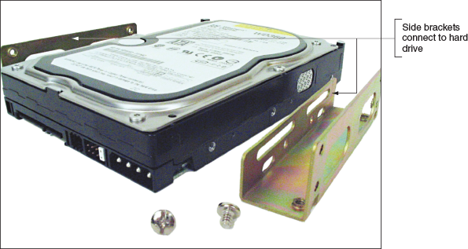
Installing a Small Drive in a Wide Bay (2 of 2)
Figure 5-30 Use the universal bay kit to make the drive fit the bay

Slide 38
Installing an M.2 SSD Card
Read the motherboard manual to find out the types of M.2 cards the board supports
Do the following to install the card:
1. Measure the length of the card and decide which screw hole for the M.2 slot the card requires
Install standoff in hole
2. Slide the card straight into the slot, but not from an upward angle
3. Install the one screw in the standoff to secure the card to the motherboard
4. Start the system, go into BIOS/UEFI setup, and make sure the M.2 card is recognized by the system

Slide 39
Installing a Hard Drive in a Laptop (1 of 2)
General guidelines:
See manufacturer’s documentation for drive sizes, form factors, and connector types
Be aware of voiding manufacturer’s warranty
If the old drive has crashed, you’ll need the recovery media to reinstall Windows and the drivers
If you are upgrading from a low-capacity drive to a higher-capacity drive, you need to consider how you will transfer data from the old drive to the new one
Considerations when shopping for a laptop drive:
Laptop drive is 2.5 or 1.8 inches wide
Some high-end laptops use an M.2 SSD
For a 2.5” drive, expect it to use the SATA interface

Slide 40
Installing a Hard Drive in a Laptop (2 of 2)
Older laptop computers required disassembly
Newer laptops should be easy to replace
Power down system, remove peripherals, and remove the battery pack
Remove a screw that holds the drive in place
Open the lid of the laptop slightly
Turn the laptop on its side and push the drive out of its bay
Remove the plastic cover from the drive and move the cover to the new drive
Insert the new drive in the bay, replace the screw, and power up the system
BIOS/UEFI should recognize the new drive and search for an OS
If drive is new, boot from the Windows setup or recovery DVD and install the OS

Slide 41
Setting Up Hardware RAID
RAID (Redundant Array of Inexpensive Disks)
Also called: Redundant Array of Independent Disks
A technology that configures two or more hard drives to work together as an array of drives
Why use RAID?
To improve performance by writing data to two or more hard drives to that a single drive is not excessively used
To improve fault tolerance by writing two copies of it, each to a different hard drive

Slide 42
Types of RAID (1 of 3)
Spanning: sometimes called JBOD (just a bunch of disks)
Uses two hard drives to hold a single Windows volume
When one drive is full, data is written to second drive
RAID 0: uses two or more physical disks
Writes to physical disks evenly across all disks so that no one disk receives all activity
Windows calls RAID 0 a striped volume
RAID 1: Mirroring (mirrored volume)
Duplicates data on one drive to another drive and is used for fault tolerance
RAID 5: uses three or more drives
Stripes data across drives and uses parity checking and data is not duplicated
RAID 10: RAID 1+0 (pronounced RAID one zero)
Combination of RAID 1 and RAID 0
Takes at least 4 disks and data is mirrored across pairs of disks

Slide 43
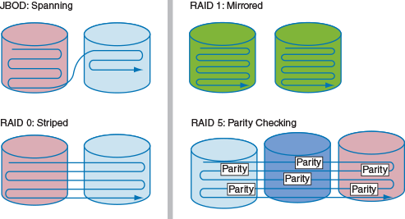
Types of RAID (2 of 3)
Figure 5-36 Ways that hard drives can work together

Slide 44
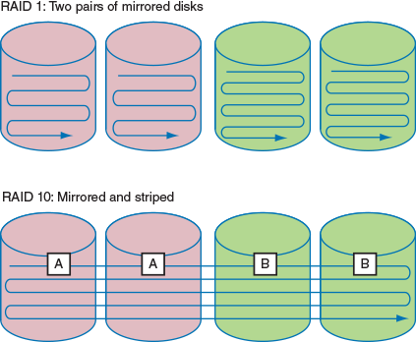
Types of RAID (3 of 3)
Figure 5-37 RAID 1 and RAID 10

Slide 45
How to Implement Hardware RAID (1 of 4)
Hardware RAID can be set up by using:
A RAID-enabled motherboard that is managed in BIOS/UEFI setup
A RAID controller card
For best RAID performance:
All hard drives in an array should be identical in brand, size, speed, other features
If Windows is to be installed on a RAID hard drive
RAID must be implemented before Windows is installed

Slide 46
How to Implement Hardware RAID (2 of 4)
General directions to install a RAID 5 array using three matching SATA drives
Install drives in the computer case and connect each drive to motherboard
Boot system and enter BIOS/UEFI setup
Verify drives are recognized, select option to configure SATA, and select RAID
Reboot the system
Press <Ctrl+I> to enter the RAID configuration utility
Select option 1 to “Create RAID Volume”
Under RAID Level, select RAID 5 (Parity) and Strip Size value
Enter the size of the volume
Select Create Volume to complete the RAID configuration

Slide 47
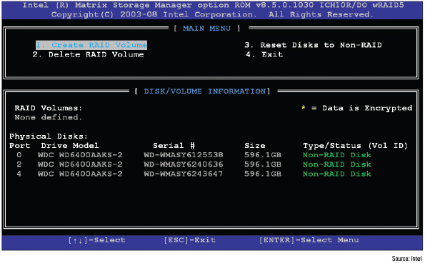
How to Implement Hardware RAID (3 of 4)
Figure 5-40 Use a BIOS/UEFI utility to configure a RAID array

Slide 48
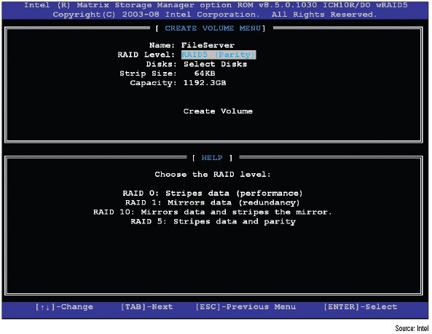
How to Implement Hardware RAID (4 of 4)
Figure 5-41 Make your choices for the RAID array

Slide 49
NAS Devices and External Storage (1 of 2)
Hard drives are sometimes stored in external enclosures
Make it easy to expand storage capacity of a single computer or make available hard drive storage to an entire network
For network attached storage (NAS)
The enclosure connects to the network via an Ethernet port
Hard drives inside the enclosure might use a SATA connection

Slide 50
NAS Devices and External Storage (2 of 2)
What to know about supporting external enclosures:
An enclosure might contain firmware that supports RAID
To replace a hard drive in an enclosure, see the documentation for the enclosure
If a computer case is overheating, remove hard drives from the case and install them in an external enclosure
It is better to leave the hard drive that contains the Windows installation in the case
You can purchase a SATA controller card that provides external eSATA connectors to be used when:
The motherboard eSATA port is not functioning
The motherboard does not support a fast SATA standard that your hard drives use

Slide 51
Supporting Other Types of Storage Devices
This section covers:
File systems that other types of storage devices use
The following types of storage devices:
Optical discs
USB flash drives
Memory cards

Slide 52
File Systems Used By Storage Devices (1 of 2)
File system – used to manage data stored on a device
Overall structure the OS uses to name, store, and organize files on a drive
In Windows, each storage device or group of devices (RAID) is assigned a driver letter and is called a volume
Formatting – installing a new file system on a device
Types of file systems:
NTFS
exFAT
FAT32 and FAT
CDFS (Compact Disc File System) or UDF (Universal Disk Format)
A newer version of UDF is used by DVDs and BDs (Blu-ray discs)

Slide 53
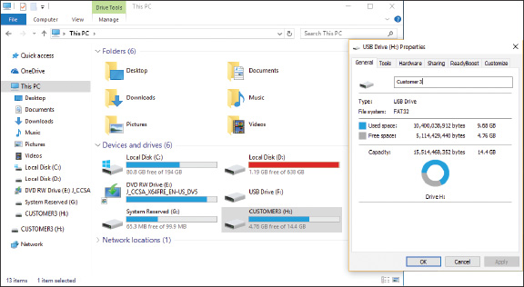
File Systems Used By Storage Devices (2 of 2)
Figure 5-44 This 16-GB USB flash drive is using the FAT32 file system

Slide 54
Standards Used By Optical Discs and Drives (1 of 4)
CDs (compact discs), DVDs (digital versatile discs or digital video discs), and BDs (Blu-ray discs) use similar laser technologies
Tiny lands and pits on surface represent bits read by a laser beam
Optical Discs:
Data can be written to:
One side of a CD
One or both sides of a DVD or Blu-ray disc
DVD or Blu-ray disc can hold data in two layers on each side

Slide 55
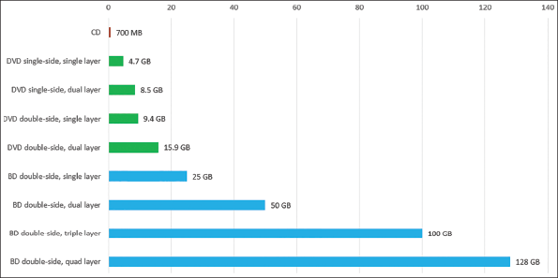
Standards Used By Optical Discs and Drives (2 of 4)
Figure 5-47 Storage capacities for CDs, DVDs, and BDs

Slide 56
Standards Used By Optical Discs and Drives (3 of 4)
Optical Drives and Burners:
Blu-ray drives are backward compatible with DVD and CD technologies
DVD drives are backward compatible with CD technologies
Depending on the drive features, an optical drive might be able to read and write to BDs, DVDs, and CDs
A drive that can write to discs is commonly called a burner
Today’s internal optical drives interface with the motherboard via a SATA connection
An external drive might use an eSATA or USB port

Slide 57
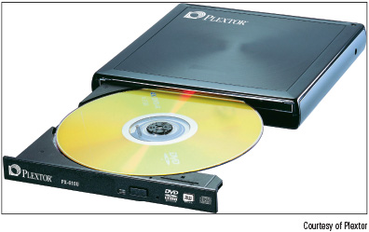
Standards Used By Optical Discs and Drives (4 of 4)
Figure 5-49 The PX-610U external DVD±RW drive by Plextor uses a USB 2.0 port

Slide 58
Installing an Optical Drive
Internal optical drives on today’s computer use a SATA interface
An optical drive is usually installed in the drive bay at the top of a desktop case
After installed in the bay, connect the data and power cables
Windows 10/8/7 supports optical drives using its own embedded drives without add-on drivers

Slide 59
Replacing an Optical Drive on a Laptop (1 of 2)
For some systems, you will need to first remove the keyboard to expose an optical drive
Replacing optical drives:
Shut down the system, unplug the AC adapter, and remove the battery pack
Remove the keyboard (not all laptops require this step)
Remove the screw holding DVD drive to the laptop
Slide drive out of the bay and new drive into the bay
Ensure connection with drive connector at the back of the bay
Replace the screw

Slide 60
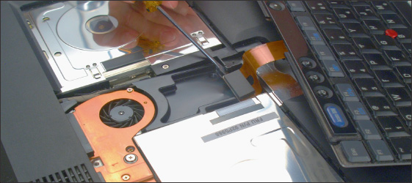
Replacing an Optical Drive on a Laptop (2 of 2)
Figure 5-53 Remove the keyboard to expose the optical drive.

Slide 61
Solid-State Storage (1 of 3)
Solid-state storage includes:
SSDs, USB flash drives, and memory cards
USB flash drives go by many names:
Flash pen drive, jump drive, thumb drive, and key drive
Flash drives might work at USB 2.0 or USB 3.0 speed and use FAT or exFAT file system
Windows 10/8/7 has embedded drivers to support flash drives
Memory cards might be used in:
Digital cameras, tablets, smartphones, MP3 players, digital camcorders, etc…
Most laptops have memory card slots provided by a built-in smart card reader

Slide 62
Solid-State Storage (2 of 3)
Secure Digital (SD) cards are the most popular memory cards
Three standards for capacity used by SD cards:
1.x (regular SD)
2.x (SD High Capacity or SDHC)
3.x (SD eXtended Capacity or SDXC)
SD cards come in three physical sizes: full-size, MiniSD, and MicroSD
SDHC and SDXC slots are backward compatible with SD cards
Cannot use:
An SDHC card in an SD slot
An SDXC card in an SDHC or SD slot
SD and SDHC cards use FAT file system
SDXC cards use exFAT file system

Slide 63
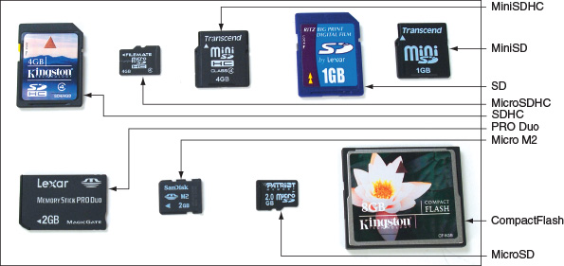
Solid-State Storage (3 of 3)
Figure 5-60 Flash memory cards

Slide 64
Troubleshooting Hard Drives
Problems caused by hard drive during the boot can be caused by:
Hard drive subsystem
File system on the drive
Files required by Windows when it begins to load
When trying to solve a problem with the boot
Decide if the problem is caused by hardware or software

Slide 65
Slow Performance (1 of 2)
One of the most common complaints:
Computer is running slowly
The overall performance of a system depends on the individual performances of:
The processor, motherboard, memory, and hard drive
To optimize a drive:
You can use Windows tools or tools provided by the hard drive manufacturer
Use the Windows Defrag and Optimization tool (dfrgui.exe) to verify that Windows is defragmenting a magnetic drive and trimming an SSD

Slide 66
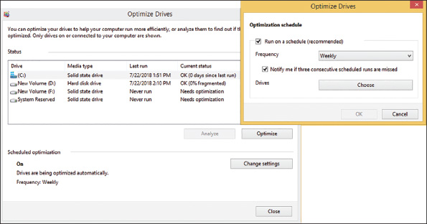
Slow Performance (2 of 2)
Figure 5-61 Windows reports volume C: is trimmed and volume D: is not fragmented

Slide 67
Hard Drive Problems During the Boot (1 of 4)
Hardware problems usually show up at POST
If BIOS/UEFI cannot access the drive, the cause might be due to the drive, data cable, electrical system, motherboard, or a loose connection
Things to do and check before opening case:
Check to see if BIOS/UEFI displays a numeric error code or other message during POST
Check BIOS/UEFI setup for errors in the hard drive configuration
Try booting from another bootable media
For a RAID array, use the firmware utility to check the status of each disk in the array and check for errors

Slide 68
Hard Drive Problems During the Boot (2 of 4)
If the problem is still not solved, open case and check these things:
Remove and reattach all drive cables
If using a RAID or SATA controller card, remove and reseat it or place in a different slot
Inspect drive for damage
Determine if hard drive is spinning by listening to it
Check the cable for frayed edges
Check installation manual
S.M.A.R.T. errors mean data should be backed up and drive replaced as soon as possible
Use Windows tools for checking a hard drive
Windows 10/8/7 Startup Repair
chkdsk command

Slide 69
Hard Drive Problems During the Boot (3 of 4)
If the problem is still not solved, open case and check these things (continued):
Steps to take to repair an MBR hard drive:
Repair the BCD using bootrec /RebuildBCD
Repair the boot sector using bootrec /FixBoot
Repair the MBR using bootrec /FixMBR
Check the drive manufacturer’s web site for diagnostic software
Move the device to a working computer and install it as a second drive
Try these things to clean the drive and get a fresh start:
Format a hard drive volume
Use diskpart to start over with a fresh file system

Slide 70
Hard Drive Problems During the Boot (4 of 4)
If the problem is still not solved, open case and check these things (continued):
Exchange the three field replaceable units-the data cable, the storage card, and the hard drive
Try connecting the drive data cable to a different SATA connector
Reconnect or swap the drive data cable
Reseat or exchange the drive controller card
Exchange the hard drive for a known good drive
If your drive whines loudly, try replacing it
A bad power supply or a bad motherboard also might cause a disk boot failure

Slide 71
Chapter Summary (1 of 3)
A hard disk drive (HDD) can be magnetic, solid-state, or hybrid
A solid-state drive contains NAND flash memory and is more expensive, faster, more reliable, and uses less power than a magnetic drive
A hybrid hard drive (H-HDD) is a magnetic drive with an SSD buffer that improves performance
S.M.A.R.T is a self-monitoring technology whereby the BIOS/UEFI monitors the health of a hard drive
Three SATA standards provide data rates of 1.5 Gb/sec, 3.0 Gb/sec, and 16.0 Gb/sec
When selecting a hard drive, consider the interface standards, storage capacity, technology, spindle speed, interface standard, and buffer size

Slide 72
Chapter Summary (2 of 3)
SATA drives require no configuration and are installed using a power cord and a data cable
Laptop hard drives plug directly into a SATA connection on the system board
RAID technology uses an array of hard drives to provide fault tolerance and/or improvement in performance
Hardware RAID is implemented using the motherboard BIOS/UEFI or a RAID controller card
Software RAID is implemented in Windows
Multiple hard drives can be installed in a single external enclosure to expand the storage capacity of a single computer or to make hard drive storage available on a network as network attached storage (NAS)
File systems a storage device might use in Windows include NTFS, exFAT, FAT32, FAT, CDFS, and UDF
Optical discs can be recordable (CD-R) or rewritable (DVD-RW)

Slide 73
Chapter Summary (3 of 3)
Flash memory cards are a type of solid-state storage
Defragmenting a magnetic hard drive can sometimes improve slow performance of the drives
Hard drive problems during the boot can be caused by the hard drive subsystem, the file system on the drive, or files required by Windows when it begins to load
To determine if the hard drive is the problem when booting, try to boot from other media
For problems with a RAID volume, use the RAID controller firmware or RAID management software in Windows to report the status of the array and to rebuild the RAID volume
To determine if a drive has bad sectors, use the chkdsk command
Use commands within the diskpart utility to completely erase a partition on a hard drive
Field replaceable units in the hard drive subsystem are the data cable, optional storage card, and hard drive

